Slide 1

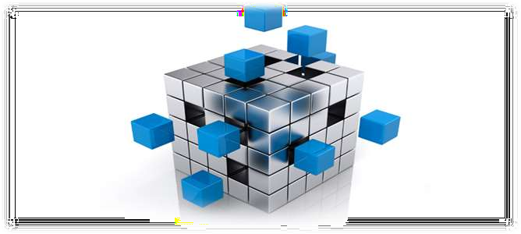

Slide 2


⦿ Merge sort is a sorting technique based on divide and conquer technique. With worst- case time complexity being Ο(n log n), it is one of the most respected algorithms.
⦿ Merge sort first divides the array into equal halves and then combines them in a sorted manner.

Slide 3

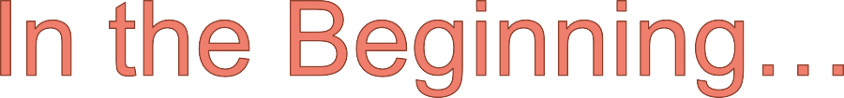
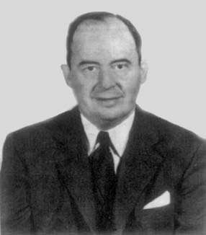
Invented by
John von Neumann (1903-1957)
⦿ Follows divide and conquer paradigm.
⦿ Developed merge sort for EDVAC in 1945

Slide 4


Divide: Divide the unsorted list into two sub lists of about half the size.
Conquer: Sort each of the two sub lists recursively until we have list sizes of length 1,in which case the list itself is returned.
Combine: Merge the two-sorted sub lists back into one sorted list.

Slide 5
⦿ MERGE SORT (A,p,r) //divide if p < r
then q= [ (p + r) / 2 ] MERGE SORT(A,p,q) MERGER SORT(A,q + 1,r) MERGE(A,p,q,r)

Slide 6
Merge(array A, int p, int q, int r)
{
array B[p..r]
i = k = p j = q+1
while (i <= q and j <= r)
{
//temp array taken
// initialize pointers
if (A[i] <= A[j]) B[k++] = A[i++]
else B[k++] = A[j++]
}
while (i <= q)
B[k++] = A[i++]
while (j <= r)
B[k++] = A[j++]
// copy any leftover to B
for i = p to r
A[i] = B[i]
// copy B back to A
}

Slide 7


99 | 6 | 86 | 15 | 58 | 35 | 86 | 4 | 0

Slide 8
99 | 6 | 86 | 15 | 58 | 35 | 86 | 4 | 0
99 | 6 | 86 | 15
58 | 35 | 86 | 4 | 0

Slide 9
99 | 6 | 86 | 15 | 58 | 35 | 86 | 4 | 0
99 | 6 | 86 | 15
58 | 35 | 86 | 4 | 0
99 6
86 15
58 35
86 | 4 | 0

Slide 10
99 | 6 | 86 | 15 | 58 | 35 | 86 | 4 | 0
99 | 6 | 86 | 15
58 | 35 | 86 | 4 | 0
99 6
86 15
58 35
86 | 4 | 0
99
6
86
15
58
35
86
4 0

Slide 11
99 | 6 | 86 | 15 | 58 | 35 | 86 | 4 | 0
99 | 6 | 86 | 15
58 | 35 | 86 | 4 | 0
99 6
86 15
58 35
86 | 4 | 0
99
6
86
15
58
35
86
4 0
4
0

Slide 12
99
6
86
15
58
35
86
0 4
Merge
4
0

Slide 13
6 99
15 86
58 35
0 | 4 | 86
99
6
86
15
58
35
86
0 4
Merge

Slide 14
6 | 15 | 86 | 99
0 | 4 | 35 | 58 | 86
6 99
15 86
58 35
0 | 4 | 86
Merge

Slide 15
0 | 4 | 6 | 15 | 35 | 58 | 86 | 86 | 99
6 | 15 | 86 | 99
0 | 4 | 35 | 58 | 86
Merge

Slide 16


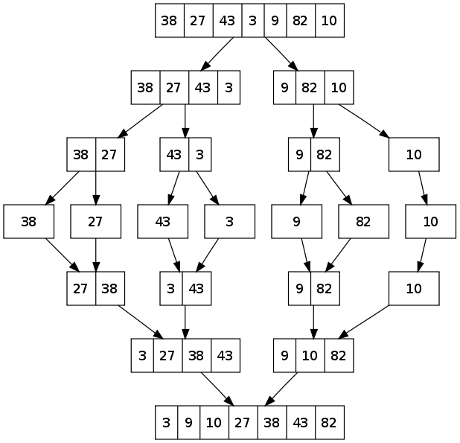


Slide 17


